Slide 1
Lab Inventory Management & Borrowing System (LIMBS)
Catherine Bradsher, Heman Kolla, Christian Marinkovich, Kellie Ng, Billy Wu, Miranda Zheng

Slide 2
What is LIMBS?
Lab Inventory Management & Borrowing System will streamline tracking, management, and usage of items within a lab or shop
Allows users to efficiently check out and return reusable equipment, or mark supplies like resistors as used
Enhances accountability for materials and equipment and reduces the need to manually track inventory
Notes:
Heman

Slide 3
User Personas & Stakeholders
Professors:
Focus more on teaching and helping students
Shop Student Leadership:
Spend less time managing inventories
All Admins:
Track which items must be restocked
Dedicate more of their budget to new equipment instead of replacements
Benefits RPI community as a whole
Lab Students:
More time with and attention from professors
Forgetful students will be less likely to accidentally lose or walk away with equipment, as they now have a written record of which items they have checked out
Notes:
Catherine

Slide 4
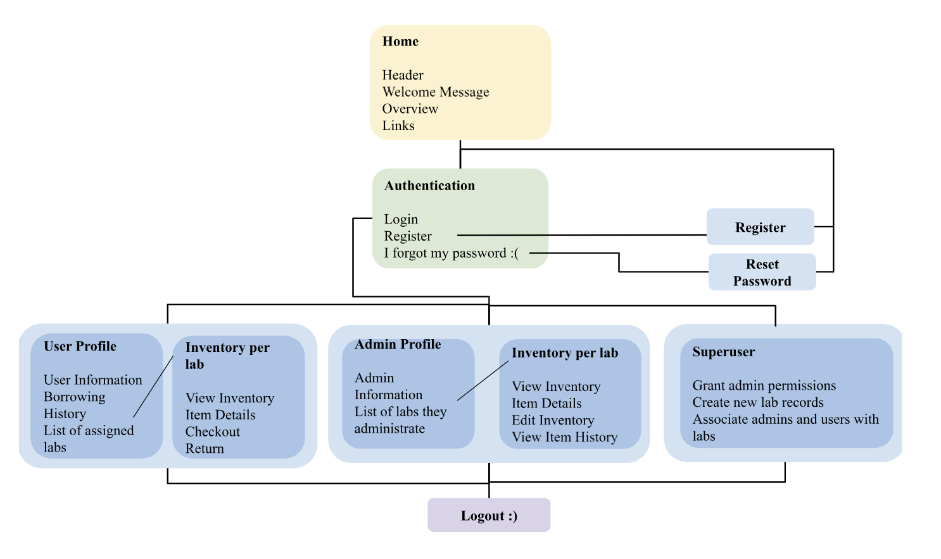
Sitemap
Notes:
Heman

Slide 5
Intended Technologies
Frontend: * HTML, CSS, JavaScript
Backend: * PHP * MySQL: - stores lab or shop’s inventory and updates status accordingly - handles user credentials and authentication process, stores usernames & passwords, roles (student or admin)
We will also use GitHub Projects
Notes:
Catherine

Slide 6
Functional Requirements
Inventory Management & Search
Administrators will be able to update inventory in real-time
Users should be able to view labs and their associated equipment/parts that the user can access
Users can search for parts/equipment they have access to via querying for name, category, availability, or use
Notes:
Kellie

Slide 7
Functional Requirements
User Authentication
Users will have their own accounts, ensuring system security permissions and user accountability
Only people with authorized access to the lab will be able to update and verify the inventory
Administrators are provided inventory management features, and will also be able to see who has checked out items, so they know who to contact to find missing items
Notes:
Kellie

Slide 8
Functional Requirements
Borrowing & Returning System
Allows users to check out items and return them, or take them (consumables)
LIMBS will record:
borrower’s information
item information
checkout date
estimated return date
LIMBS will update its inventory to reflect the item’s availability
Notes:
Christian

Slide 9
Nonfunctional Requirements
Usability - Have an interface that is easy to navigate and has a purposeful flow
Security - Have secure account authentication and authorization to help protect inventory and lab data
Scalability - Have the ability to expand and scale with growing users and more labs on campus
Adaptability - Have the system be able to adapt to other inventories such as campus shops and office inventory
Notes:
Christian

Slide 10
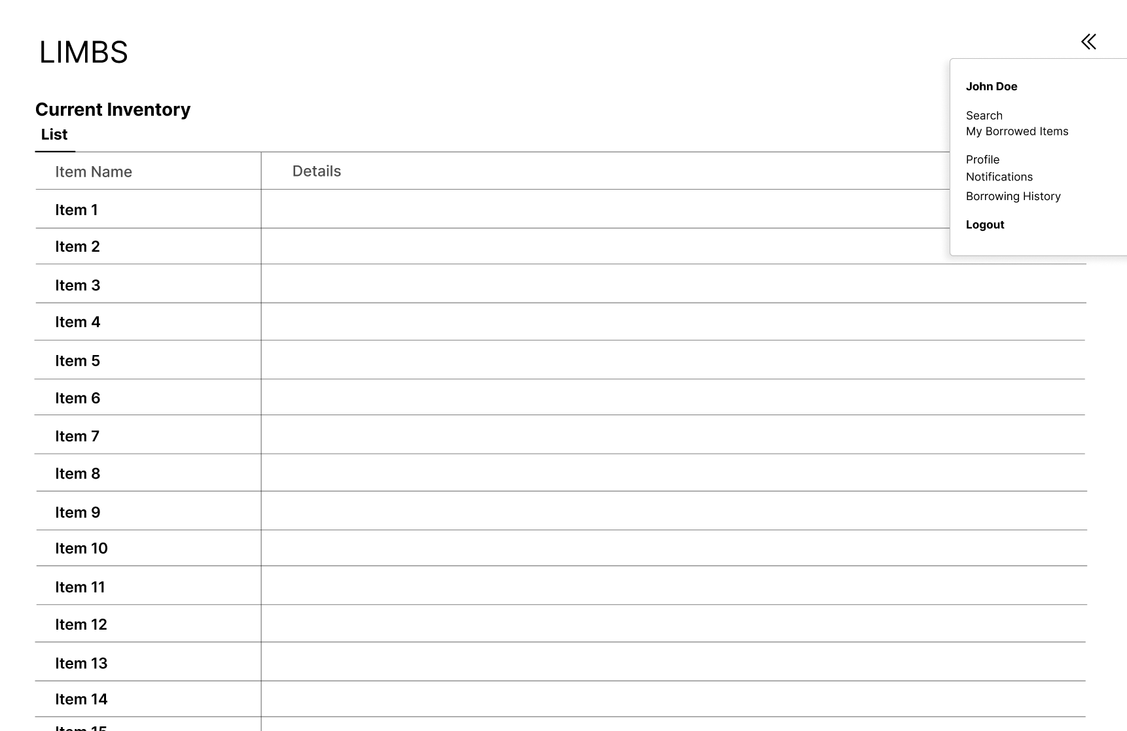
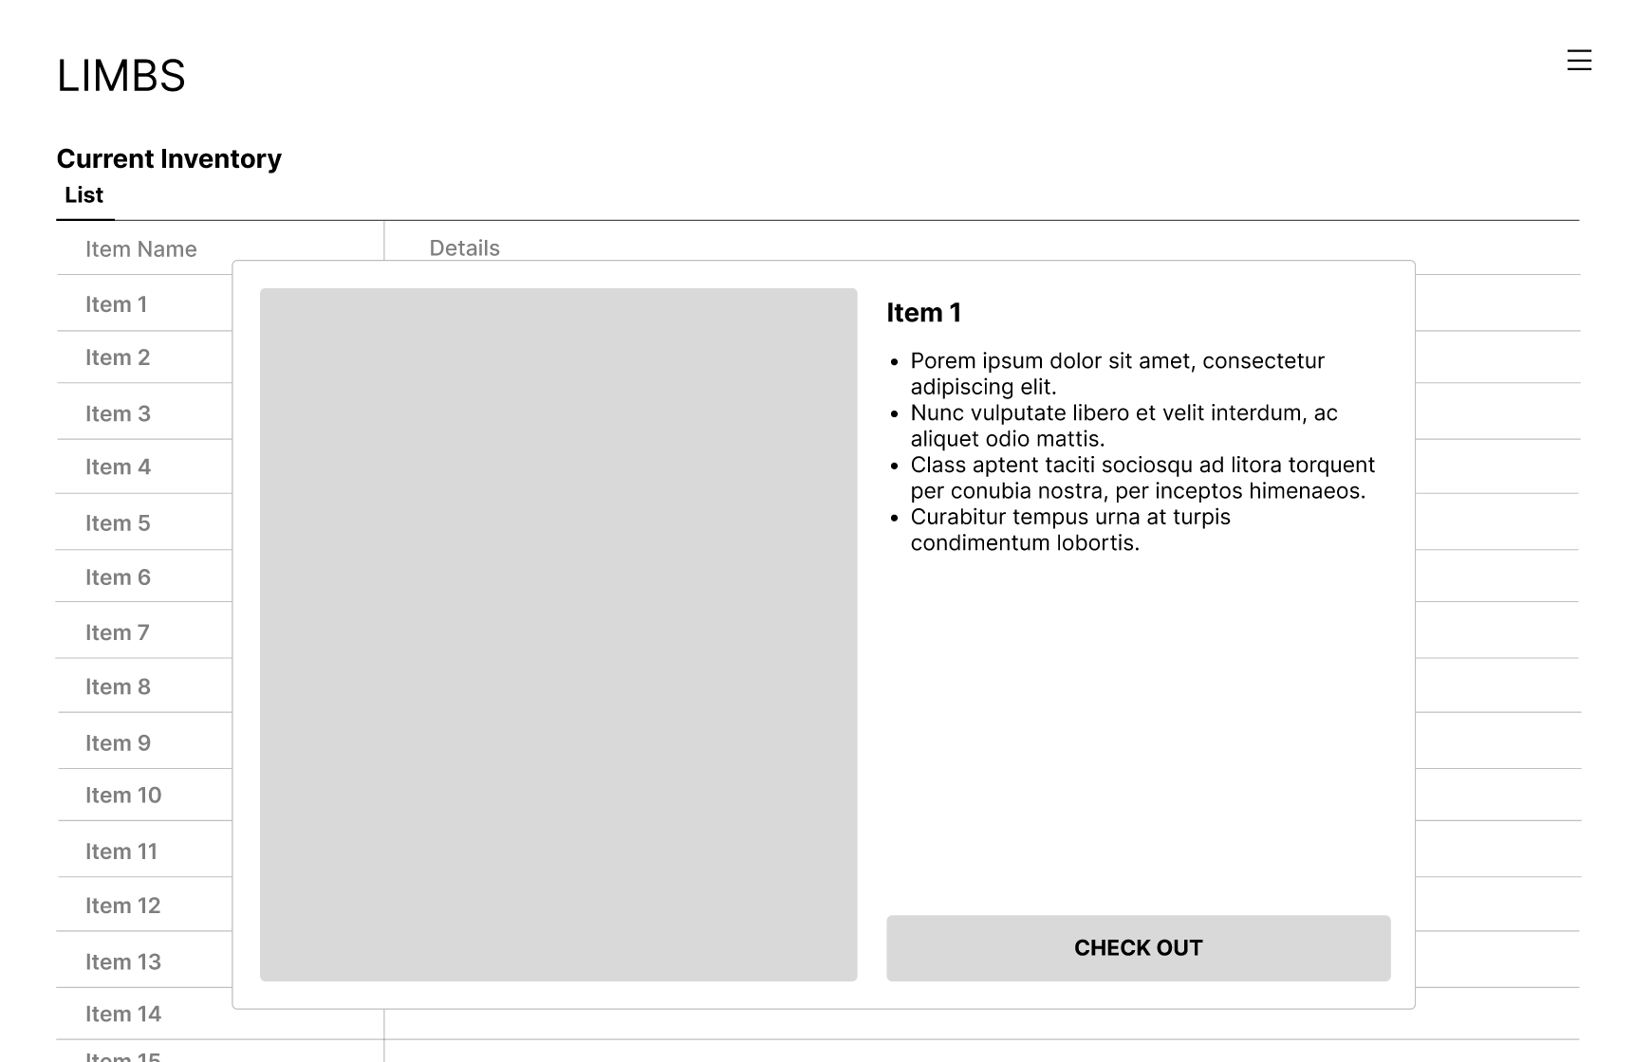
Wireframes
The following two wireframes walk through what it might look like if a user is trying to check out the item. Once logged in and the lab is selected, LIMBS will show the inventory available for that specific lab.
Notes:
Miranda

Slide 11
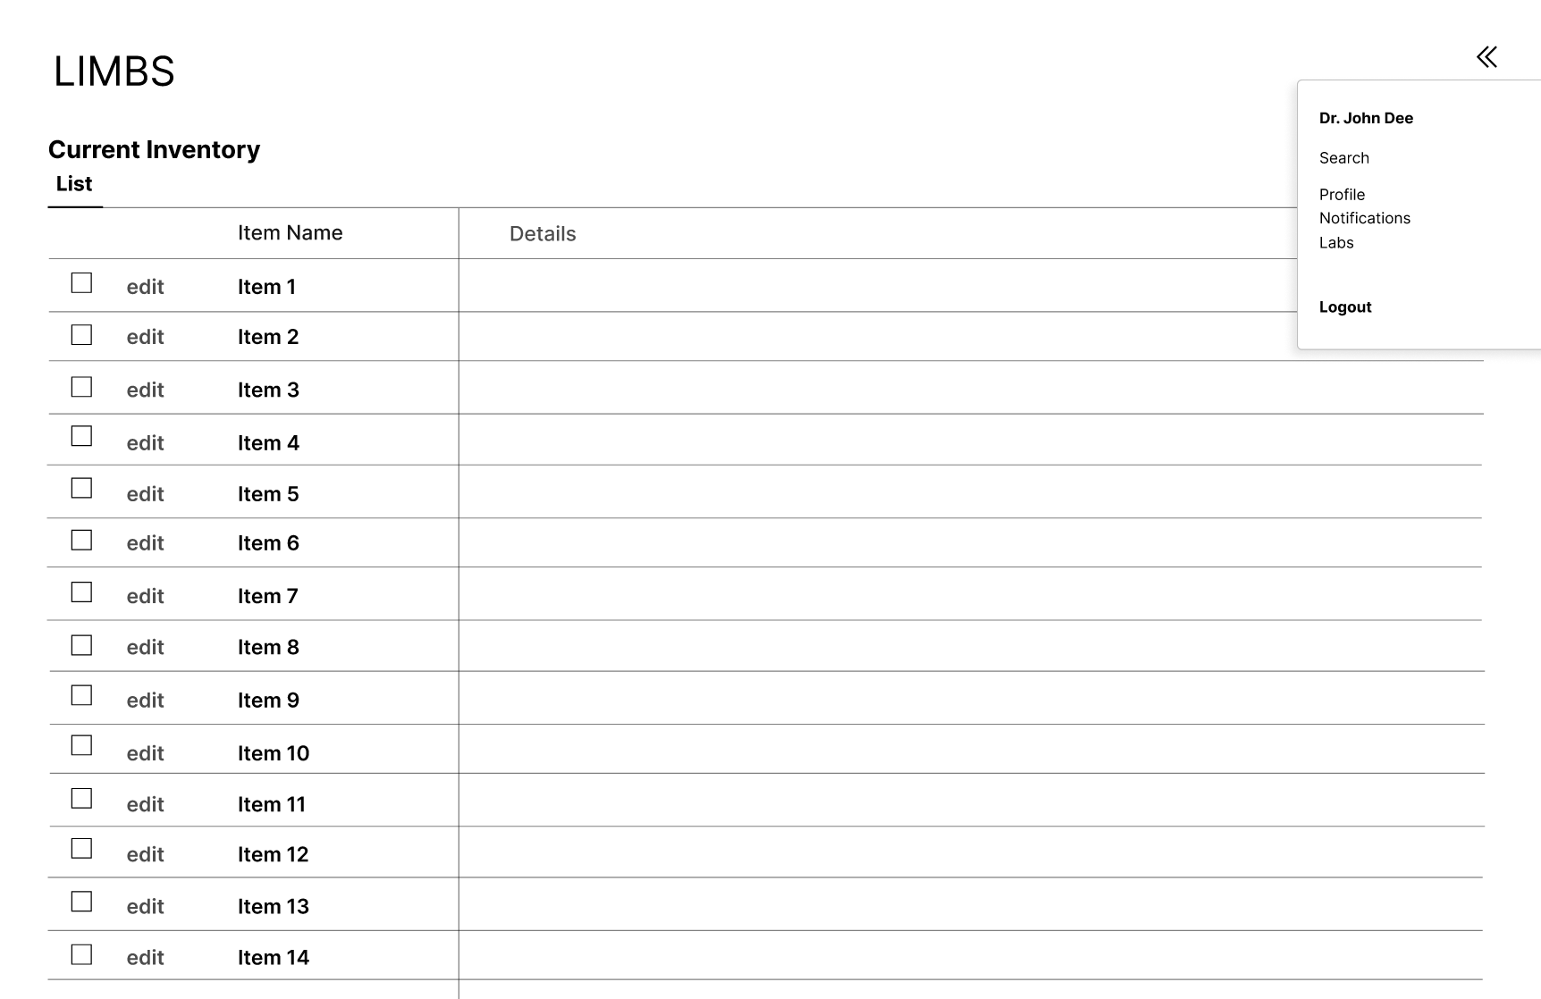
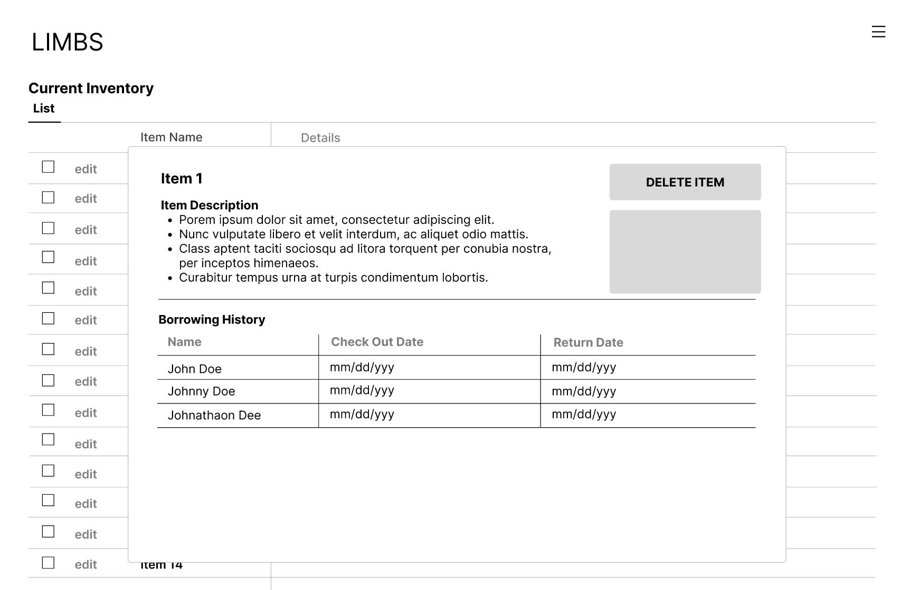
Wireframes
This wireframe is an example of what an administrator might be able to see if they log into LIMBS. The system will give them the ability to edit and select any items to change the status of them, or delete them.
Notes:
Miranda

Slide 12
General Timeline
September 9th - 23rd - Planning and designing the application and reach out to faculty for ideas
September 24th - October 14th - Begin working on frontend and backend development
October 15th - November 11th - Begin connecting the front end and the backend to ensure that the website is running smoothly
November 12th - December 2nd - Testing the application and feedback from potential users
Notes:
Billy

Slide 13
Use LIMBS!

Slide 14


